Slide 1
Outline
DCT code structure, hierarchy, loops
Calculation of function and loop latency from Latency/Loop table
Check automatic pipelining/inlining performed by the tool
Explain Schedule Viewer in greater detail
Observed deficiency in each optimization step
Reason why `Row_DCT_Loop/COL_DCT_loop` cannot do flattening
Latency and delay timing of all optimization steps
Impact of array partition on performance
C/RTL co-simulation & dataflow graph

Slide 2
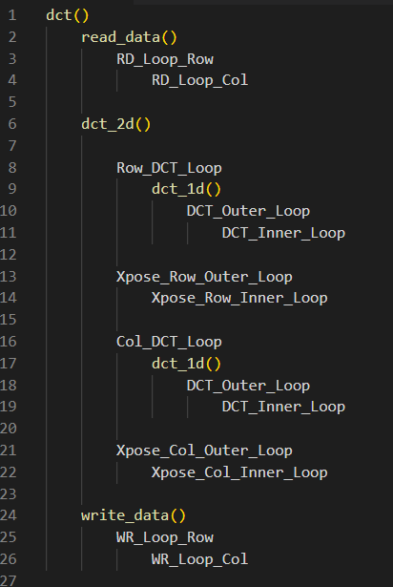
DCT code structure, hierarchy, loops
`dct()` first reads data into fpga BRAM by calling `read_data()`, then calls `dct_2d()` to process the data, finally writes the processed data out using `write_data()`.
Both `read_data()` and `write_data()` use two level nested loop to read/write data, since the input/output data is in the form of 2d array.
`dct_2d()` first perform 1d dct transform on the rows (`Row_DCT_Loop`) of input data, then perform same transform on its columns (`Row_DCT_Loop`).
In order to reuse the same function `dct_1d()`, the code transpose (`Xpose_Row_Outer/Inner_Loop`) the output of `dct_1d()` after perform 1d dct on rows, then pass this to `dct_1d()` again, then transpose (`Xpose_Col_Outer/Inner_Loop`) the output back.
`dct_1d()` internally uses two-level nested loops to perform product of input row vector of length 8 with a constant 8x8 coefficient matrix.

Slide 3
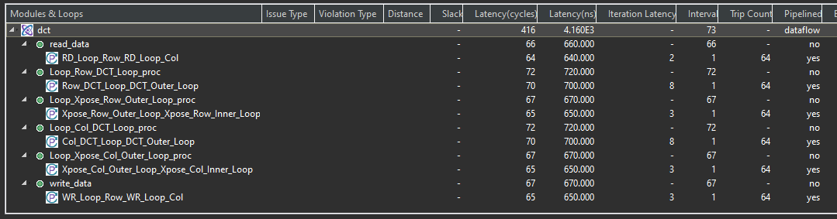
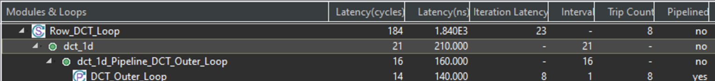
Calculation of function and loop latency from Latency/Loop table
Calculation of `latency` for function
(Interval) * (trip count) + (Iteration latency) = 1 * 64 + 2 = 66
Calculation of `latency` for loop
(Iteration latency) * (trip count) = 23 * 8 = 184

Slide 4
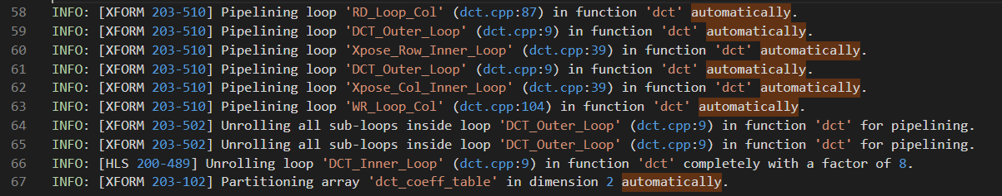
Check automatic pipelining/inlining performed by the tool

Slide 5
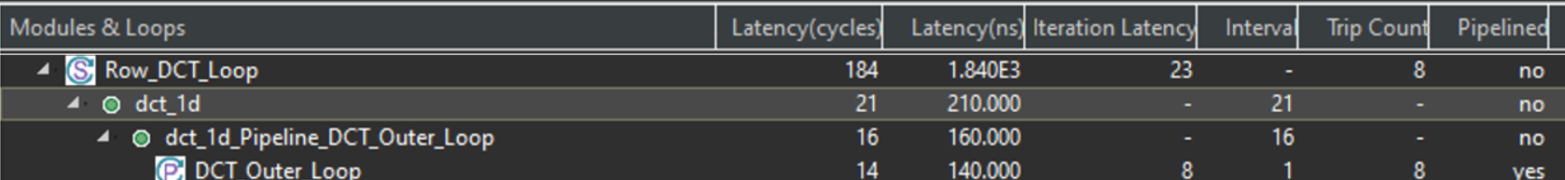
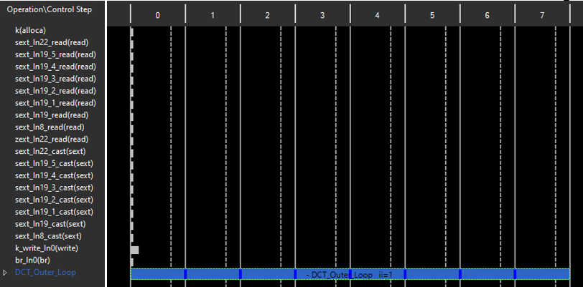
Explain Schedule Viewer in greater detail
8 cycles

Slide 6
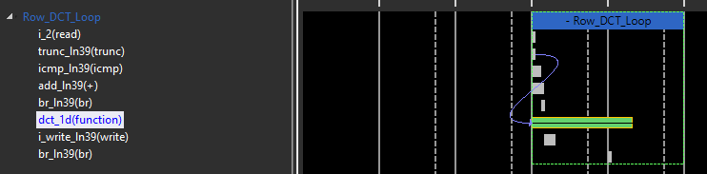
Explain Schedule Viewer in greater detail
= 21 + 2
2 cycles
21 cycles

Slide 7
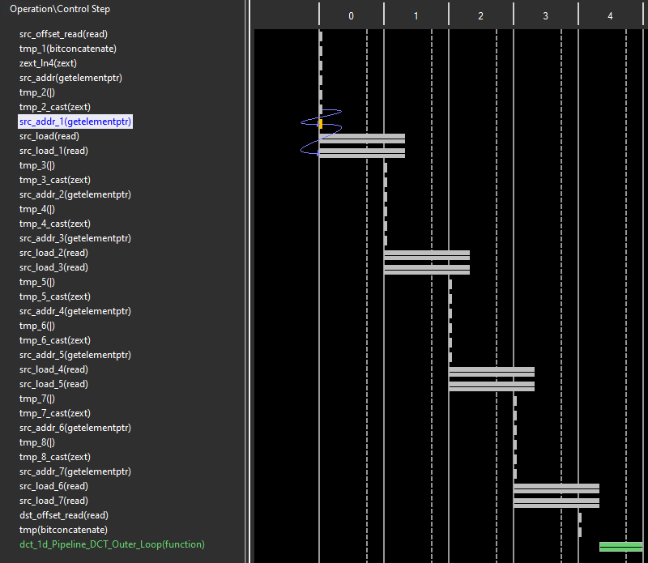
Explain Schedule Viewer in greater detail
5 cycles
= 16 + 5
16 cycles

Slide 8
Observed deficiency in each optimization step
 | Changes made | Reason
sol1 -> sol2 | Pipeline inner loops for all nested loops | Before one data finished processing, the next data cannot begin -> Most resources are idle.
Sol2 -> sol3 | Change `dct_1d` to completely unroll inner loop, and then pipeline outer loops. | Some operations in the outer loop level prevent loop flattening due to data dependency, which makes it no benefit in pipelining only the inner loop.
Sol3 -> sol4 | Parallelize memory read by partitioning `buf_2d_in` and `col_inbuf`. | Reading from single 2-port BRAM found to be the bottle neck.
Sol4 -> sol5 | Enable inter-functions/loops parallelization by applying dataflow optimization to functions/loops of `dct`. | Same reason as the one in `sol1 -> sol2`, but at functions/loops level.
Sol5 -> sol6 | Inline `dct_2d` function into its upper level function `dct`. | Many functions/loops are hidden under `dct_2d` and therefore are not them subject to dataflow optimization applied in previous step. Inlining `dct_2d` makes functions/loops of `dct_2d` to become functions/loops of `dct`, which makes them also subject to dataflow optimization applied in previous step.

Slide 9
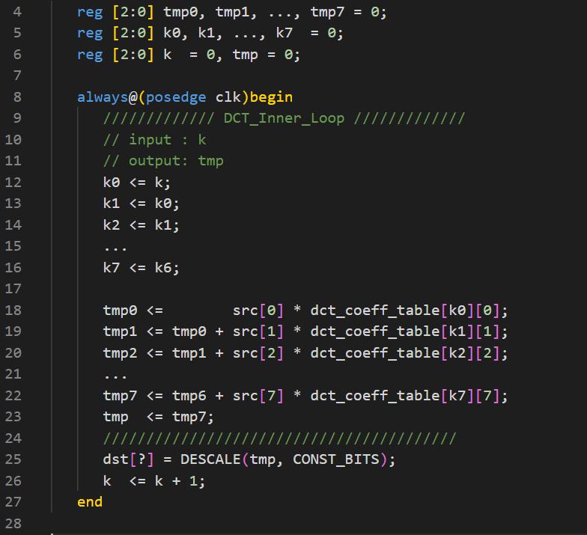
Reason why `Row_DCT_Loop/COL_DCT_loop` cannot do flattening
When we only pipeline the inner loop `DCT_Inner_Loop`, the resulting Verilog code would look like the one in Fig.8.
The pipelined `DCT_Inner_Loop can now take one new `k` value from outer loop in every clock cycle.
We now see a problem: line25 will use the output `tmp` from `DCT_Inner_Loop`, but what the `?` in `dst[?]` should be?
One correct way is make it `k7 + 3’d1`, but since `k7` in internal to `DCT_Inner_Loop` and it created as a result of performing pipelining on `DCT_Inner_Loop`, so it is not accessible to everything outside of `DCT_Inner_Loop`.
To make it possible for line25 to use `k7`, we need to perform pipeline on `DCT_Outer_Loop` instead.

Slide 10
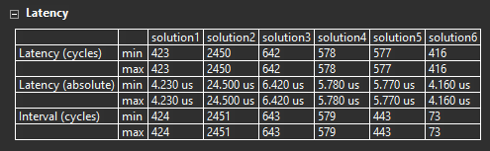
Latency and delay timing of all optimization steps
All solutions have shorter `interval` and `latency` compare with their previous ones except for solution2.
Why solution1 is so good?: the tools automatically perform several optimization (inlinings and loop flattenings) for solution1
Why the tools did not also perform as much optimization for other solution?: solution1 have no user-applied directives, while other solutions do have.

Slide 11
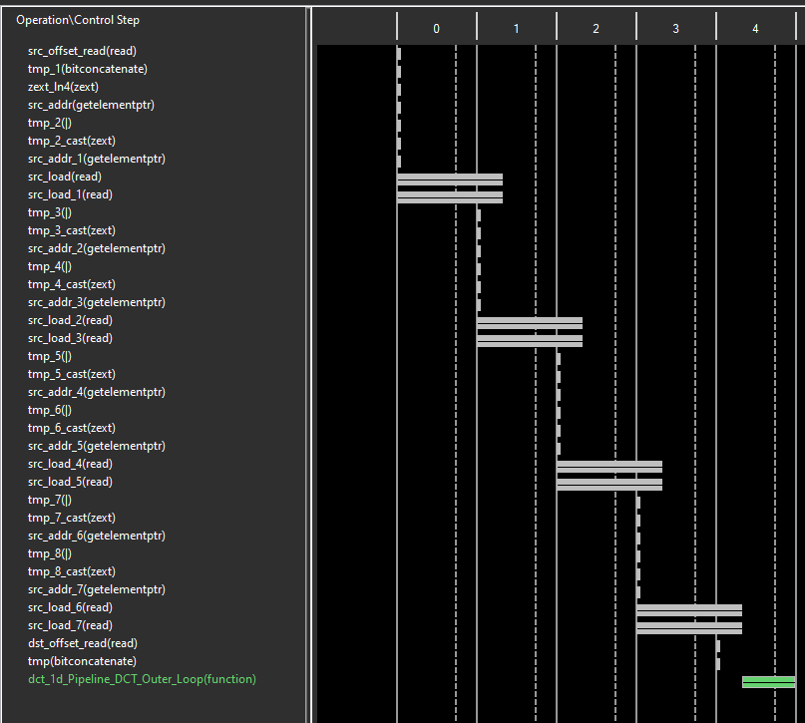
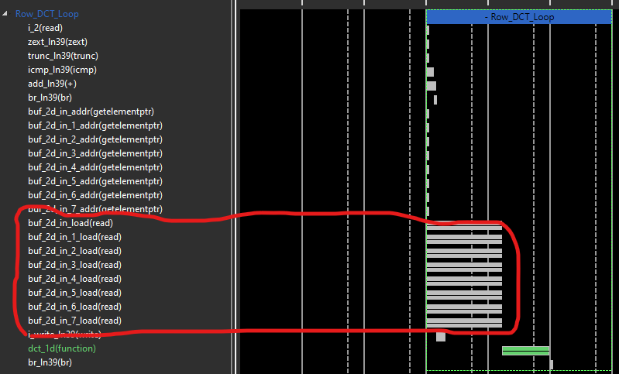
Impact of array partition on performance
 | Latency | Iteration latency | Trip count
Solution3 | 184 | 23 | 8
Solution4 | 152 | 19 | 8
With array partitioning
Without array partitioning

Slide 12
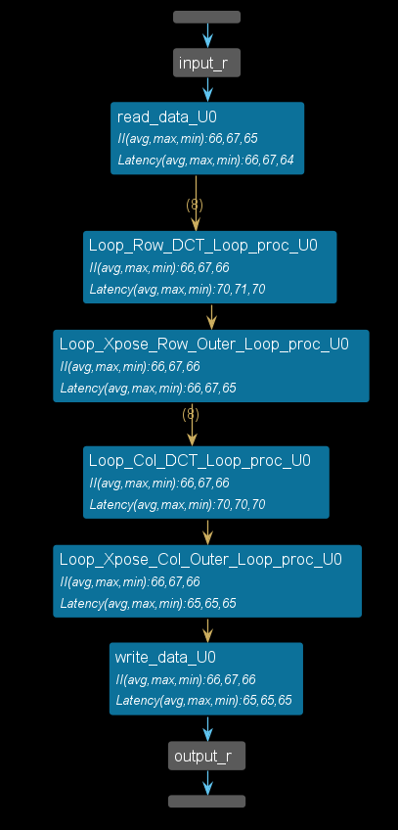

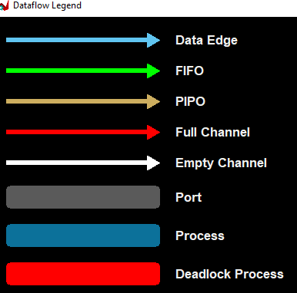
C/RTL co-simulation & dataflow graph
Run testbench 10 times to get `min`, `max`, `avg`.
No fifo used?

